Slide 1

INTERMEDIATE CODE
GENERTOR FOR C
Faculty Student
Dr. G.Michael Mano M Professor 192321151 Saveetha School of Engineering Saveetha School of Engineering
Notes:
1
1

Slide 2
Introduction
Importance of Compiler Design in Modern Programming
Role of Intermediate Code Generation
Advantages of Intermediate Representation (IR)
Focus on C Language and Its Constructs
Tools & Techniques Used: Lex/Yacc

Slide 3
Scope: Enhance Intermediate Code Generation for C
Address limitations of existing models
Improve modularity and extensibility
Enable better error handling and optimization

Slide 4
Existing Model
Traditional Intermediate Code Generators Overview
Frontend → IR → Backend Structure
Three Address Code (TAC), Quadruples
Examples from GCC and LLVM

Slide 5
Pipeline Diagram Representation
Focus on syntax tree transformations
Dependency on specific compiler architecture
General-purpose IR with limited specialization

Slide 6
Traditional Intermediate Code Generators Overview
Compilers typically follow a Frontend → IR → Backend model.
Frontend: Performs lexical, syntax, and semantic analysis.
Intermediate Representation (IR): Acts as a bridge between frontend and backend.
Backend: Converts IR to target machine code.
Common IR formats:
Three Address Code (TAC)
Quadruples
Triples

Slide 7
Limitations of Existing Intermediate Code Models
Most IR systems are based on syntax tree transformations (e.g., Abstract Syntax Trees).
Tightly coupled with specific compiler architecture (like GCC or LLVM).
General-purpose IR: Designed for broad compatibility, not for C-specific optimizations.
Minimal support for:
Advanced error tracking
Readability and maintainability in generated IR
Fine-grained semantic handling

Slide 8
Flaws in Existing Model
Inefficient handling of complex expressions
Limited portability across architectures
Lack of customization for specific optimizations
Error-prone symbol table management
Redundant intermediate code generation
Minimal support for semantic error tracing
Challenges in debugging and traceability

Slide 9
Inefficient Handling of Complex Expressions Traditional IRs struggle with deeply nested or compound expressions, especially in C. This leads to bloated or redundant code during transformation and optimization stages.
Limited Portability Across Architectures Many IRs are tightly coupled with specific hardware or compiler platforms (e.g., x86 in GCC), making it harder to adapt across multiple systems.
Lack of Customization for Specific Optimizations General-purpose IRs do not allow tailoring optimizations for particular use cases (like loop unrolling or instruction reordering in C).
Error-Prone Symbol Table Management Existing models may not handle scopes, variable lifetimes, or type mismatches robustly, leading to runtime errors or compilation crashes.

Slide 10
Redundant Intermediate Code Generation IR often includes unnecessary or repetitive instructions that increase compilation time and reduce runtime efficiency.
Minimal Support for Semantic Error Tracing Current IR systems rarely maintain links to high-level semantics, making it difficult to trace or fix logic errors in source code.
Challenges in Debugging and Traceability Due to the abstraction gap between IR and source code, identifying the exact cause of runtime issues becomes cumbersome for developers.

Slide 11
Proposed Model
Custom Intermediate Code Generator for C
Modular Design with Error Handling
Enhanced Symbol Table and Expression Handling
Improved Maintainability and Optimization

Slide 12
Implementation
Input C Code → Intermediate Code Output
Includes symbol table and expression parsing
Screenshot or code snippet of implementation
IR Output Format: Quadruples/Triples
Error handling mechanisms included
Supports various statement types (assignments, loops)

Slide 13
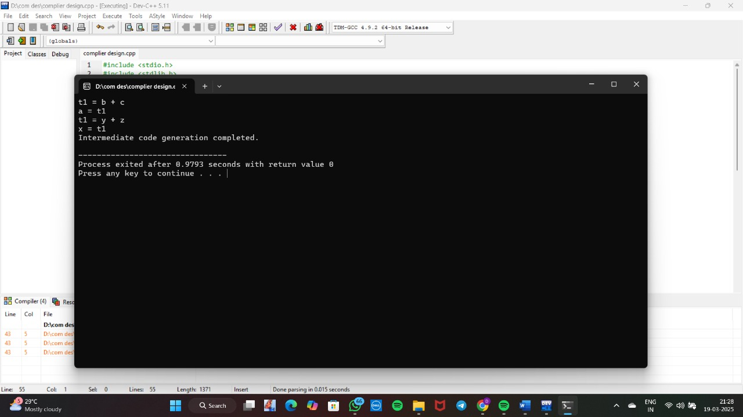

Slide 14
Results and Discussion
The custom Intermediate Code Generator was successfully implemented for a subset of C.
Generated IR follows a structured Three Address Code (TAC) format.
Improved clarity in code transformations and symbol tracking.
Successful test cases included arithmetic operations, conditionals, loops, and nested expressions.

Slide 15
Reduced Redundancy: Output IR contains fewer unnecessary temporaries and operations compared to GCC-generated IR for the same input.
Improved Error Traceability: Semantic error markers included in the IR help track undeclared variables, type mismatches, and out-of-scope references effectively.
Cleaner Symbol Table Handling: Variable scopes and lifetimes are better managed through a custom symbol table mechanism.

Slide 16
Discussion
The generator proves beneficial for educational use, compiler prototyping, and IR visualization tools.
While effective for simpler C programs, scaling to handle complete C features (like pointers, structs, and memory management) requires further enhancements.
Compared to LLVM or GCC pipelines, this model prioritizes readability and customizability over raw performance or optimization depth.

Slide 17
Future Enhancements
Support for Complex C Constructs (pointers, structs)
Integration with Backend Code Generator
Adaptability to Other Programming Languages

Slide 18
Thank You

